Slide 1

Final Year Project
Group Members
Imran Abbas
Abdul Nisar
Ambreen Zahra
Supervisor
Sir Jahanzaib Ali Khan

Slide 2
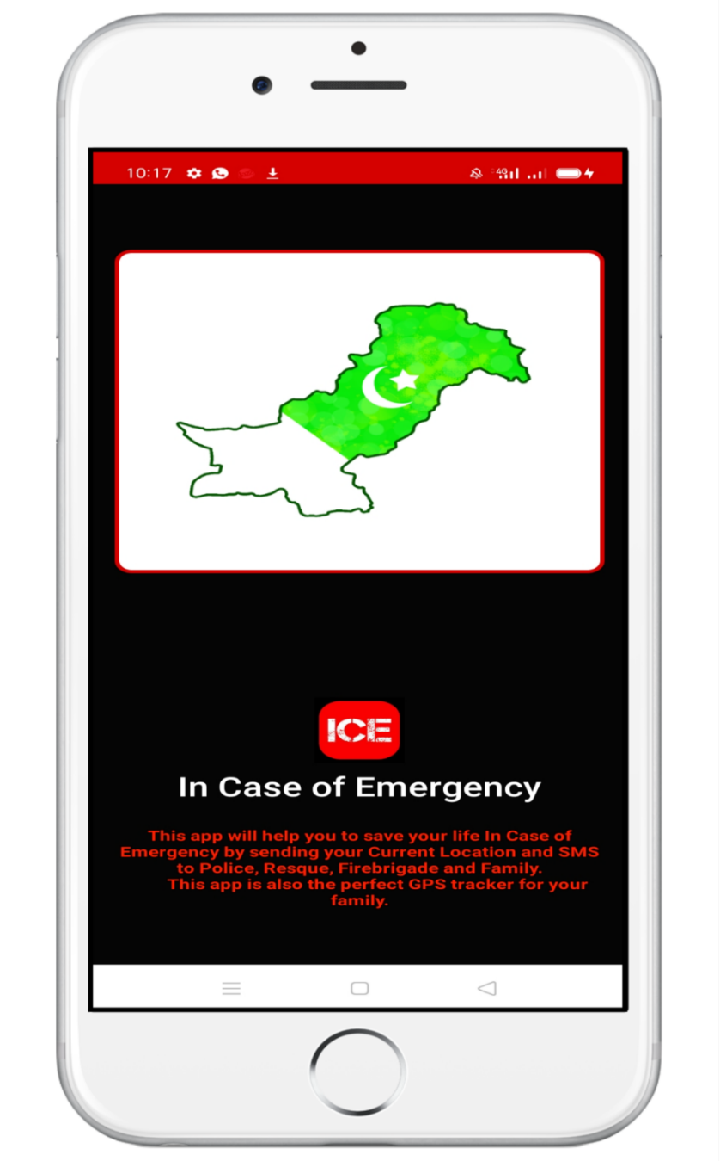
ICE
IN CASE OF EMERGENCY Mobile App Is Android Base Application That Helps You To Send Real Time Location And SMS To Police, Rescue Fire Brigade And Home Through Click On A Single Button.

Slide 3
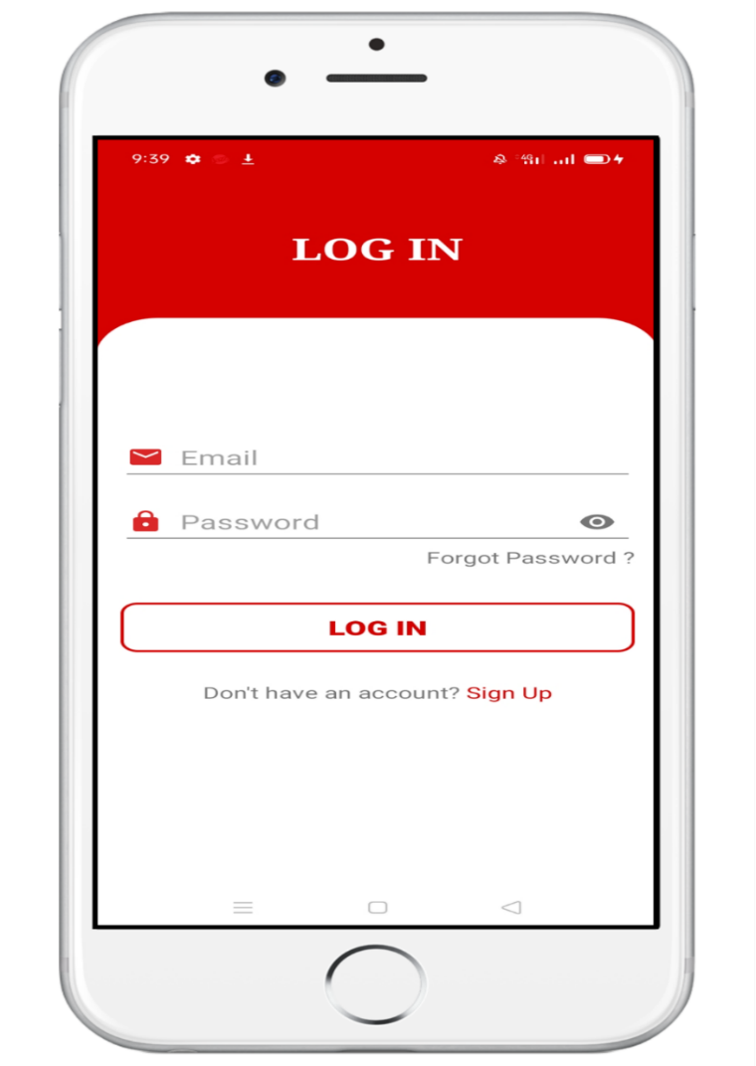
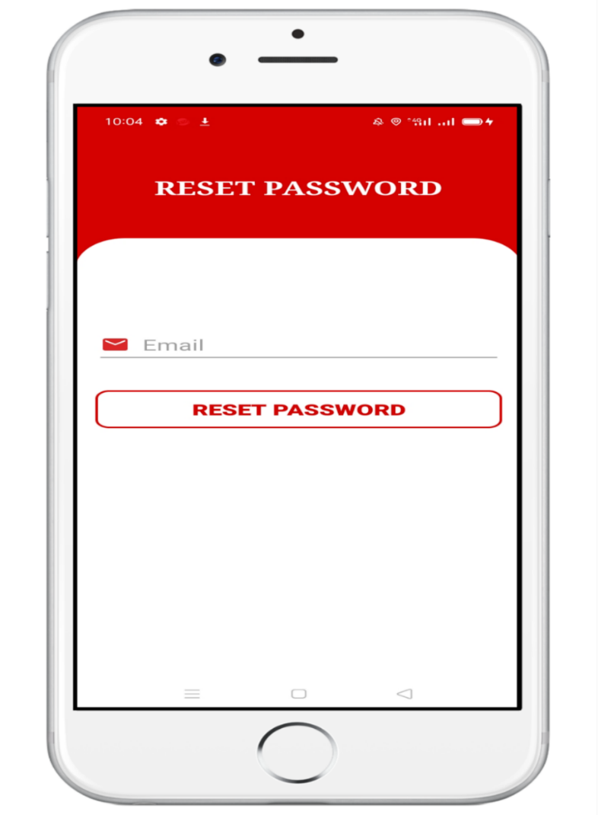
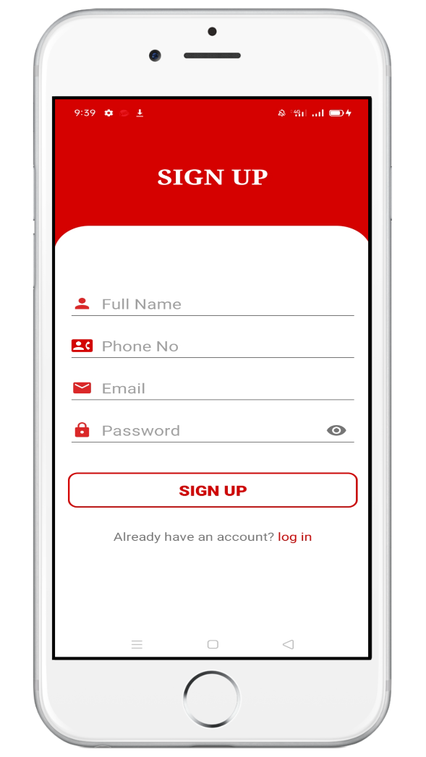
Welcome To In Case Of Emergency

Slide 4
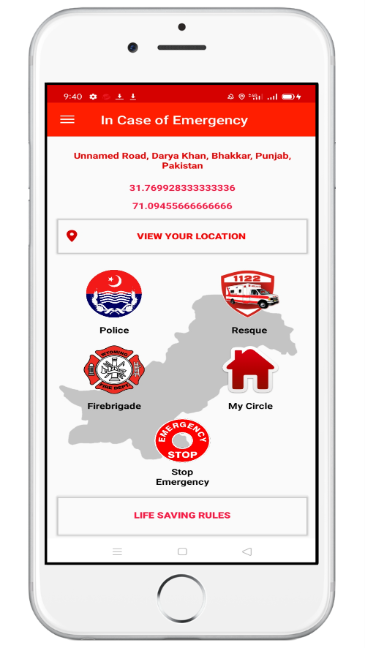
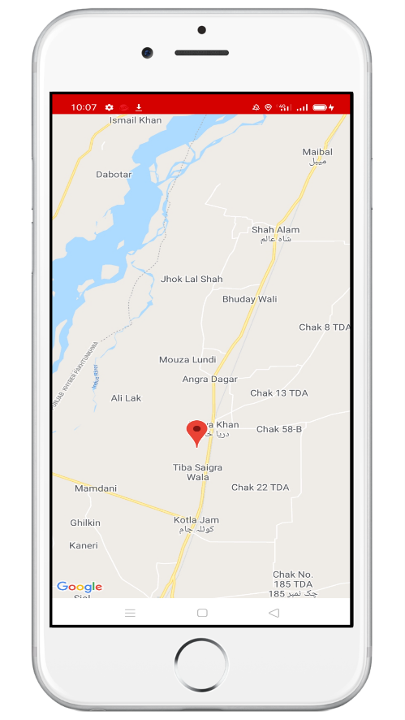
Home View Location
Real Time Location
GPS
Street Address
Life Saving Rules

Slide 5
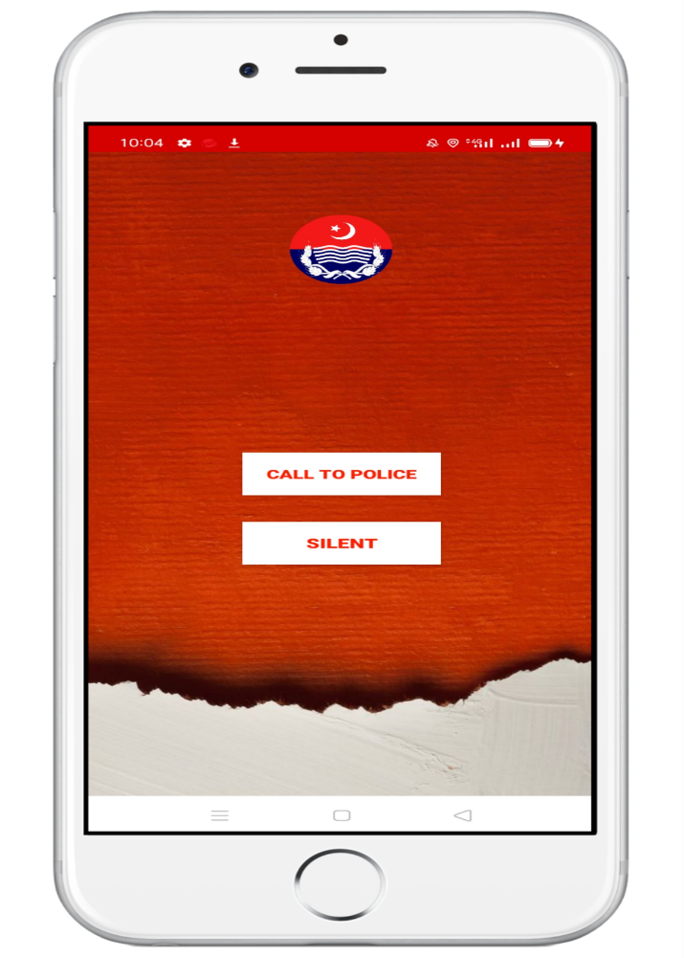
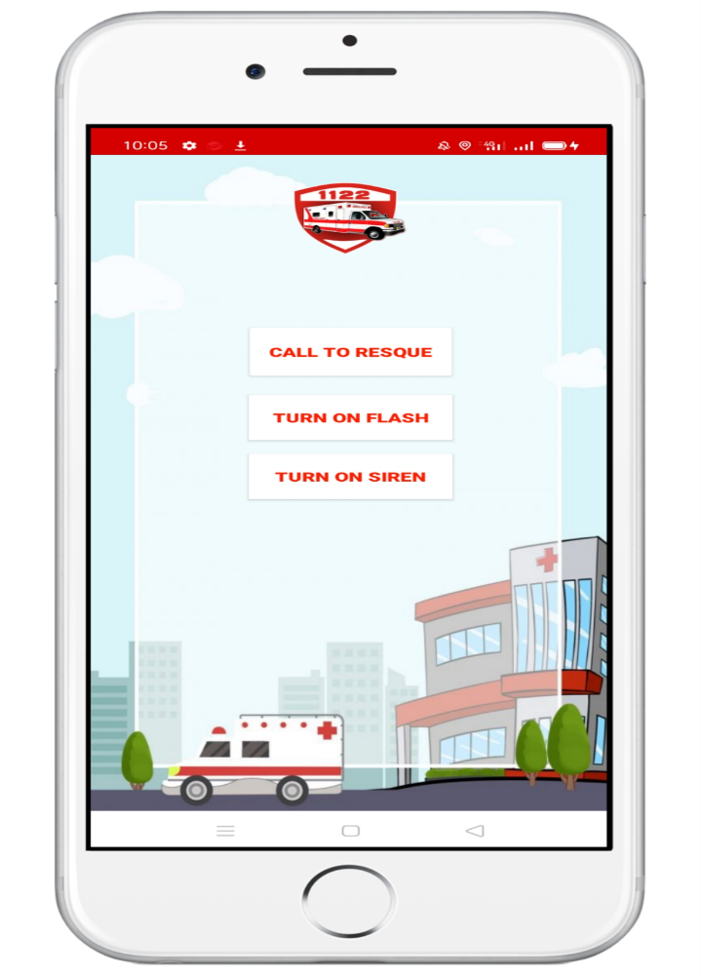
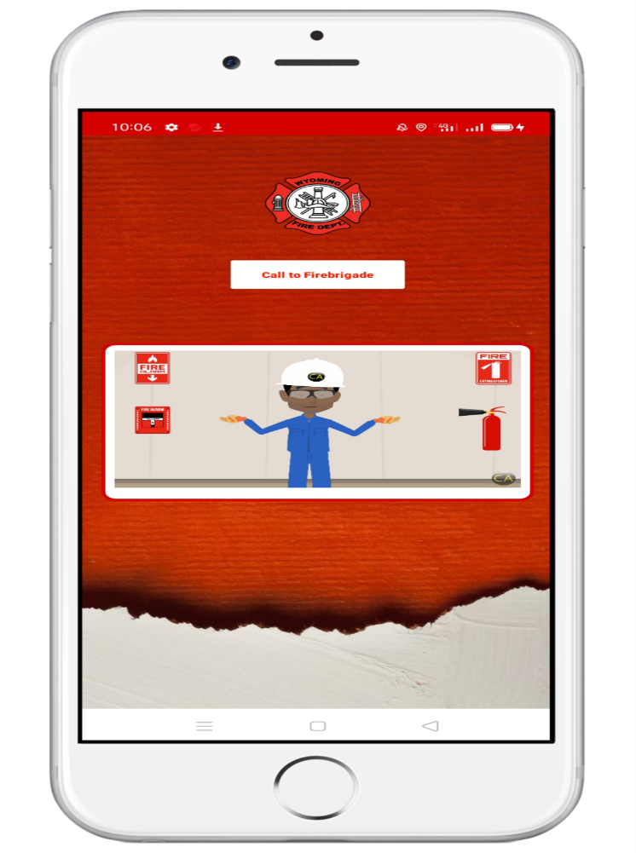
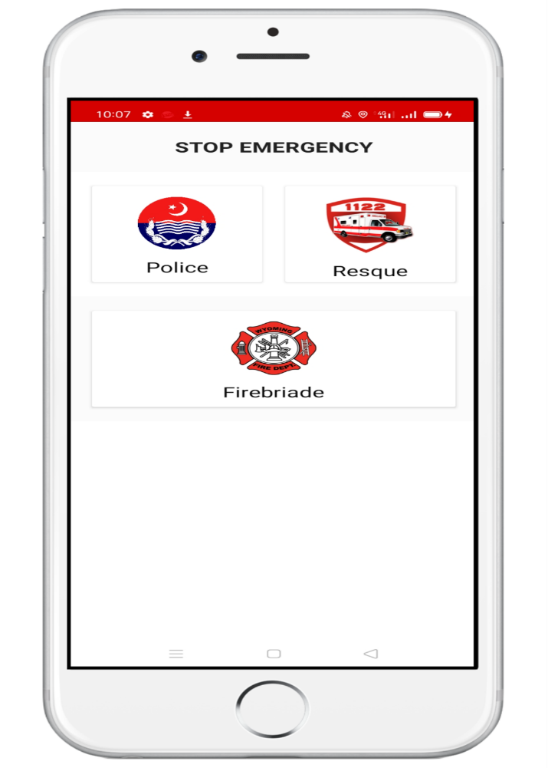
Police Help
Rescue Help
Fire Brigade Help
Stop Emergency
How to stop emergency if you don’t need help
Location
SMS
Mobile Turn to Silent
Location
SMS
Flashlight and Siren Turn On
Location
SMS
How to control fire

Slide 6
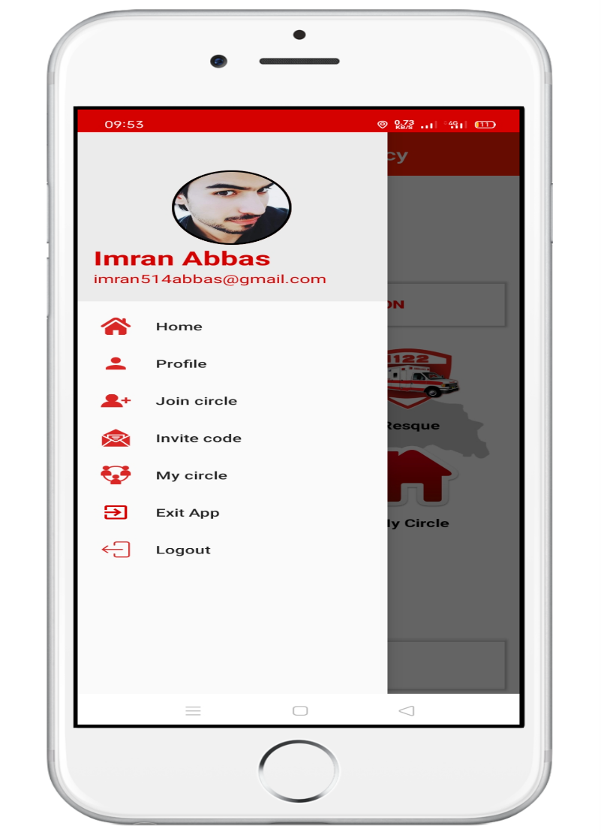
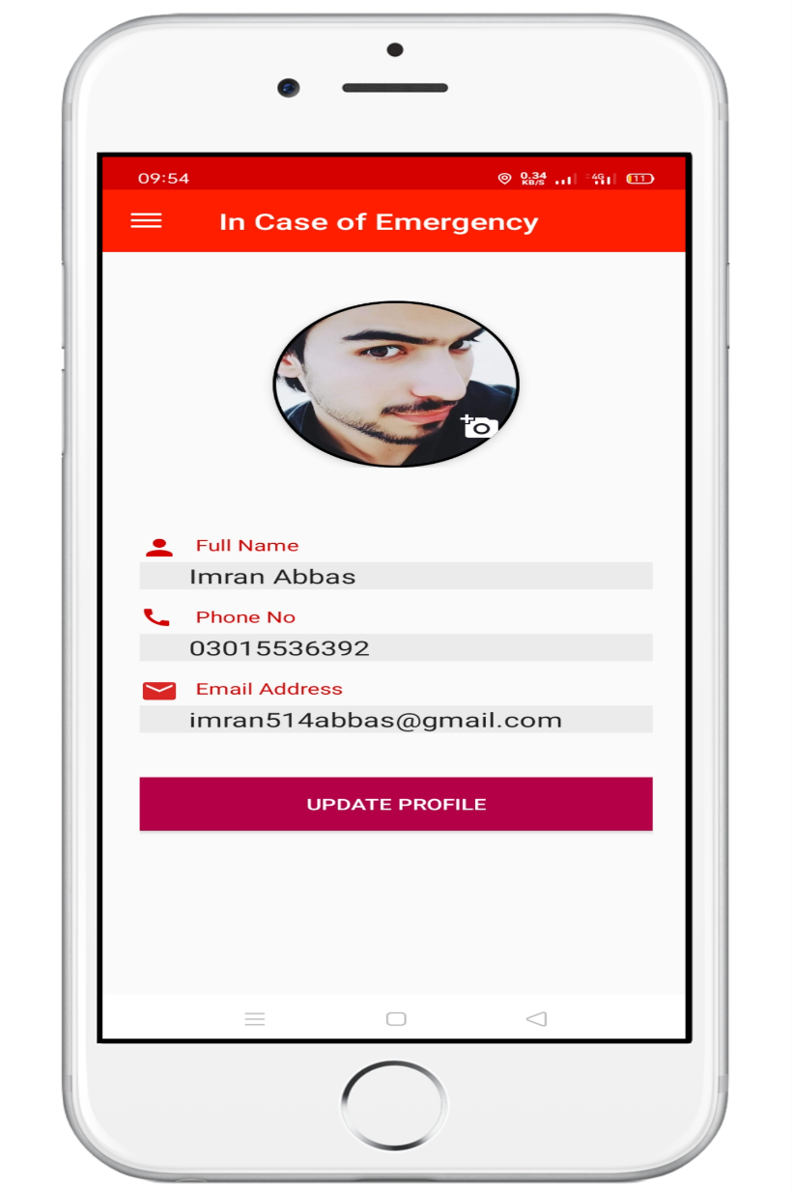
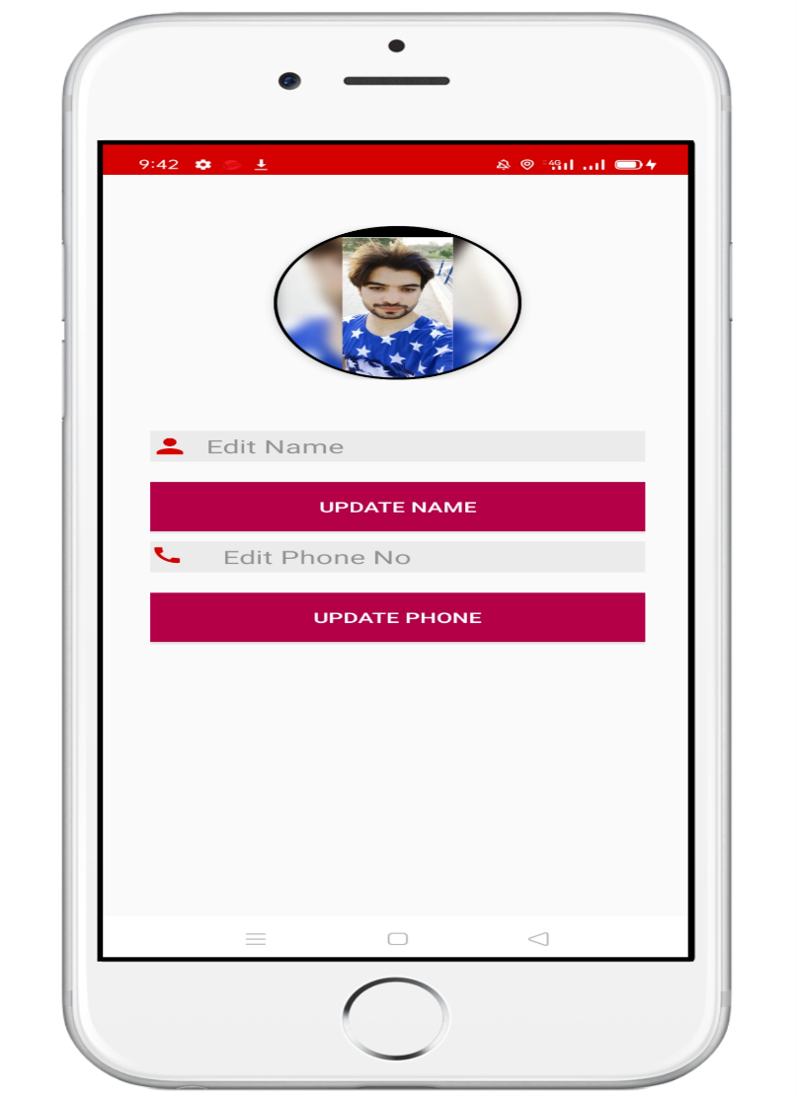
Navigation drawer
Add YourProfile
Update Your Profile

Slide 7
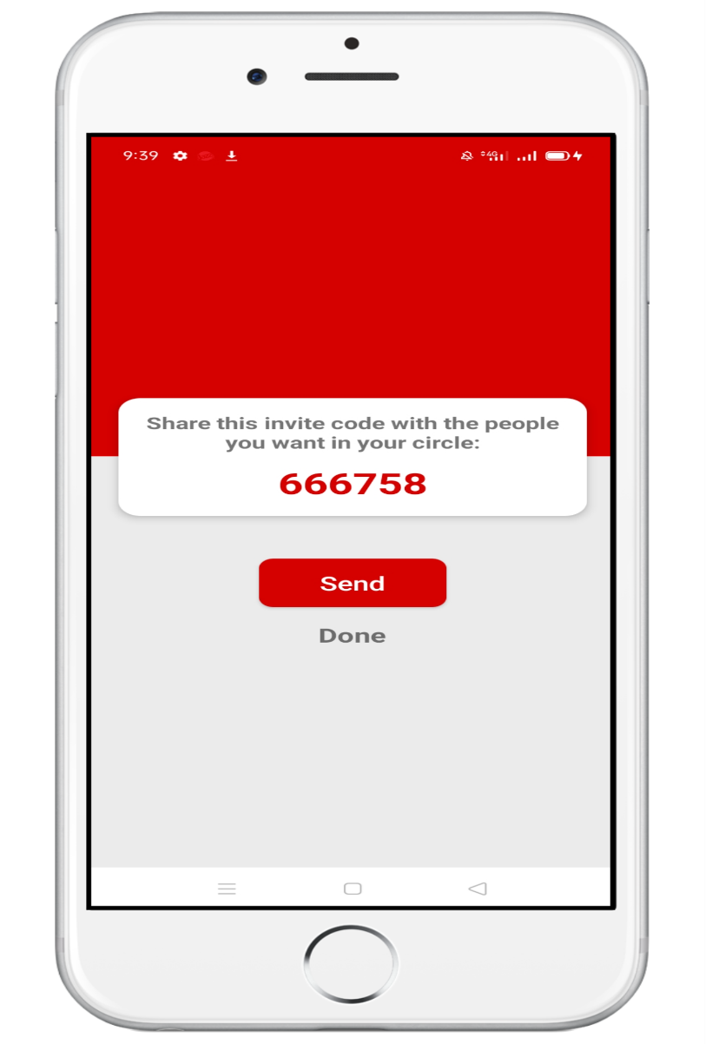
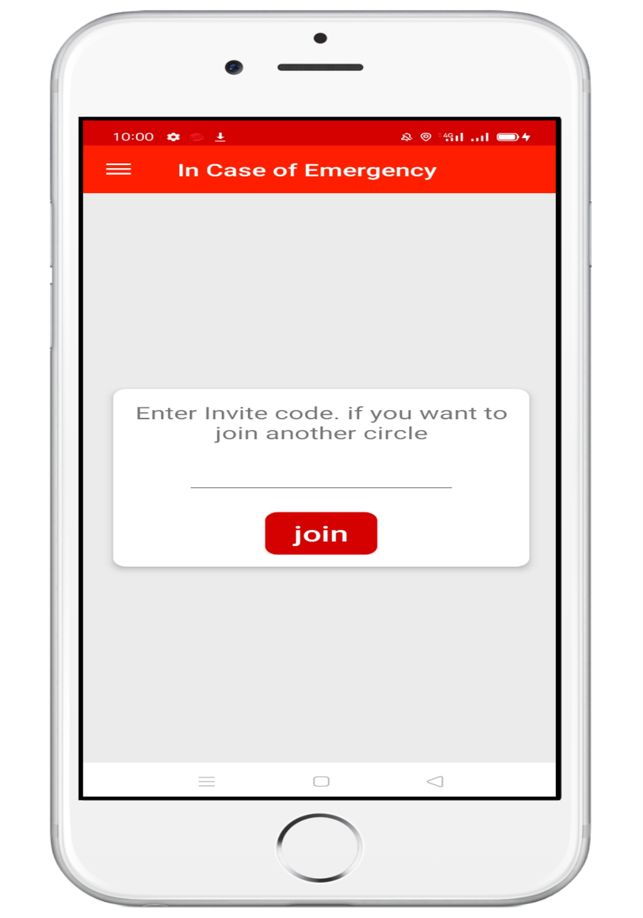
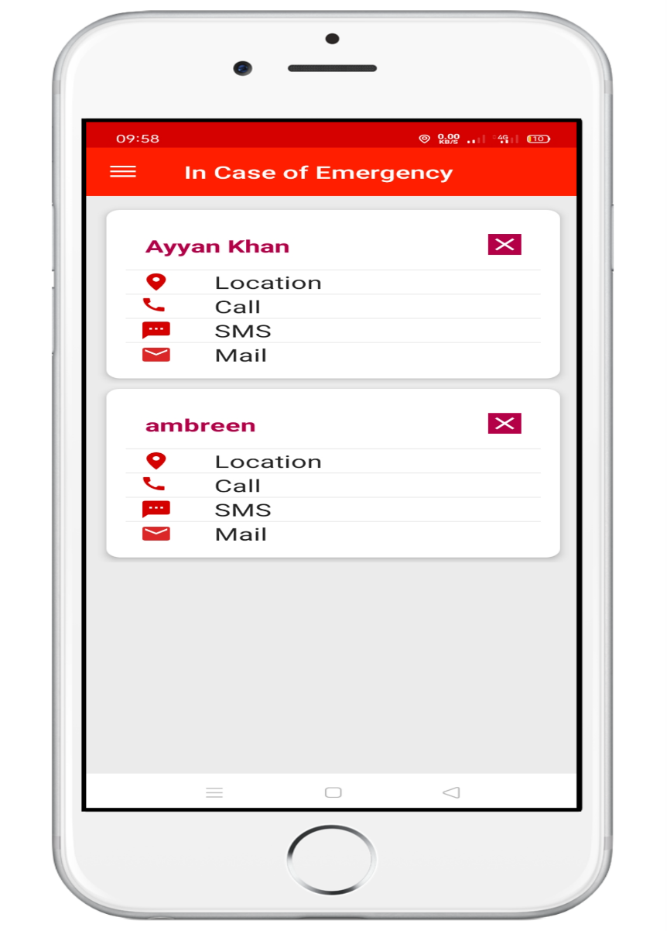
Add People In Your Circle
Join Another Circle
View People In Your
Circle

Slide 8
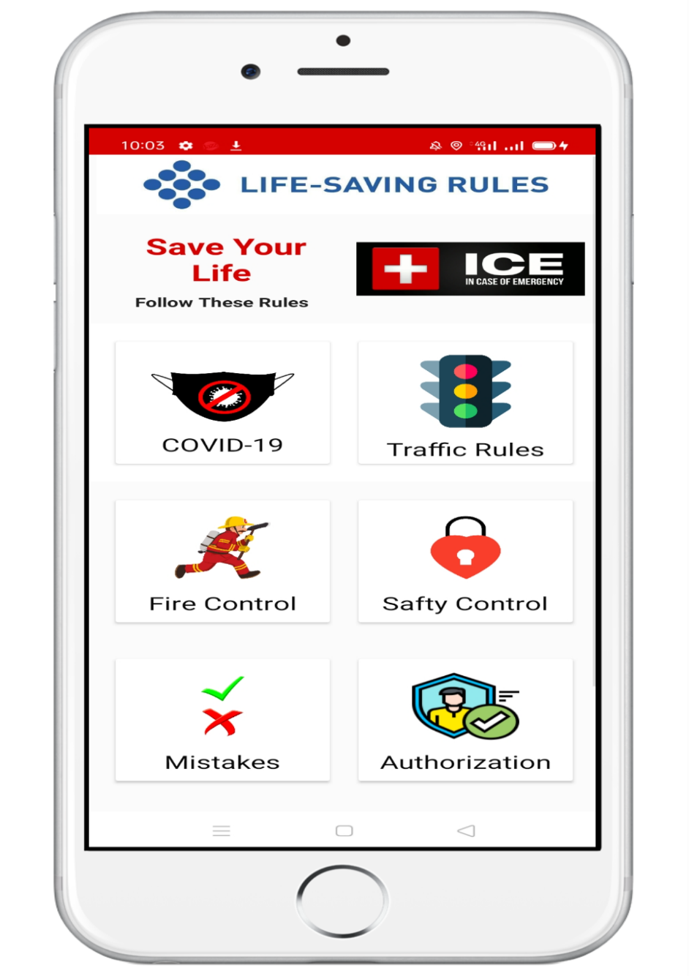
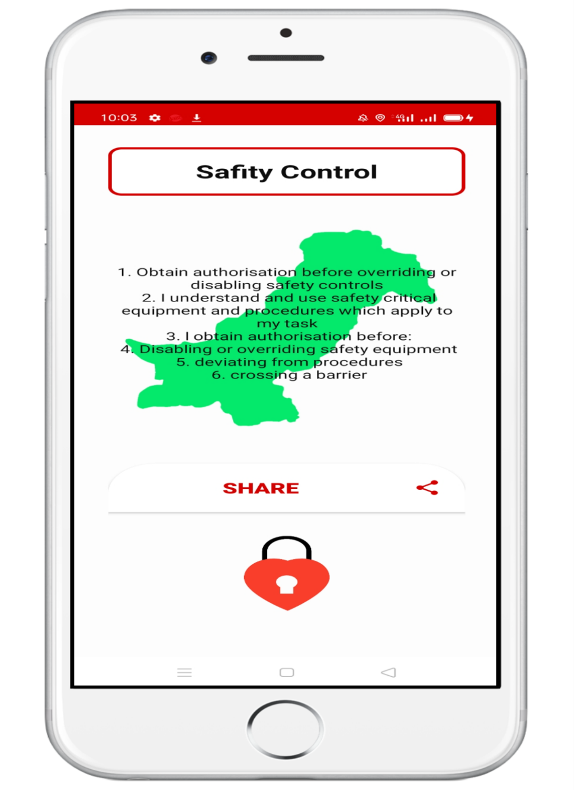
Share These Rules Through
List Of Life Saving Rules
COVID-19
Road Crossing
Traffic Rules
Earthquake
Safety sign
Valid Work
Fire Control
Common Mistakes
Messages
WhatsApp
Twitter
Facebook
Instagram
Gmail

Slide 9
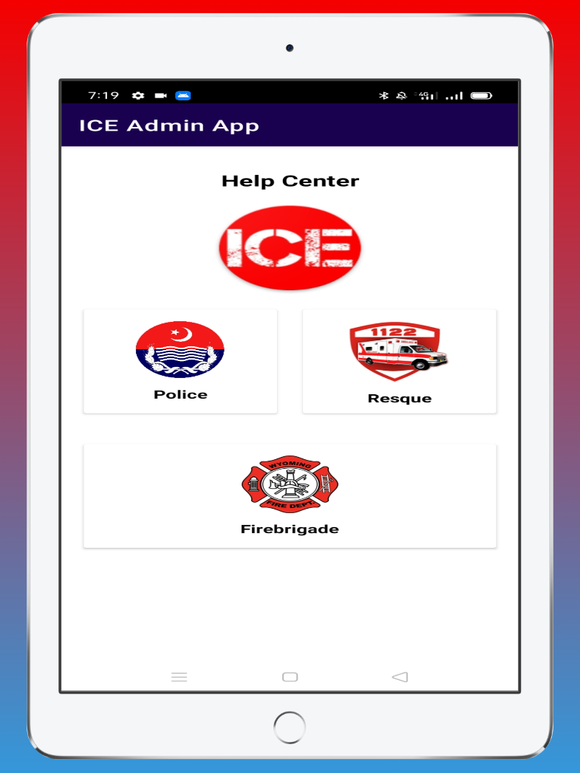
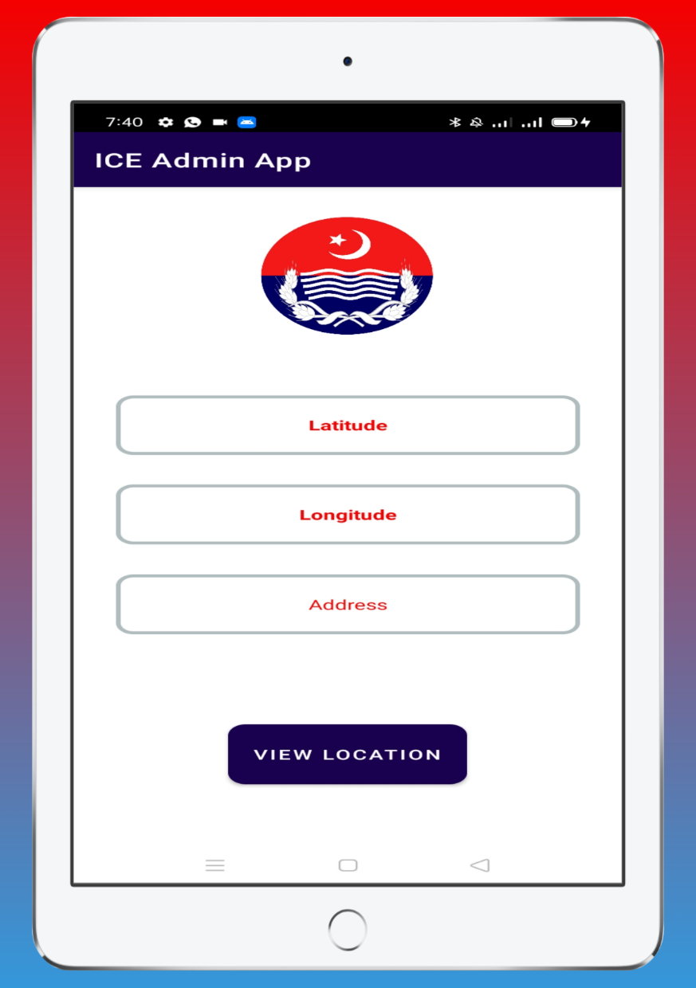
Admin Side Police Help Center

Slide 10
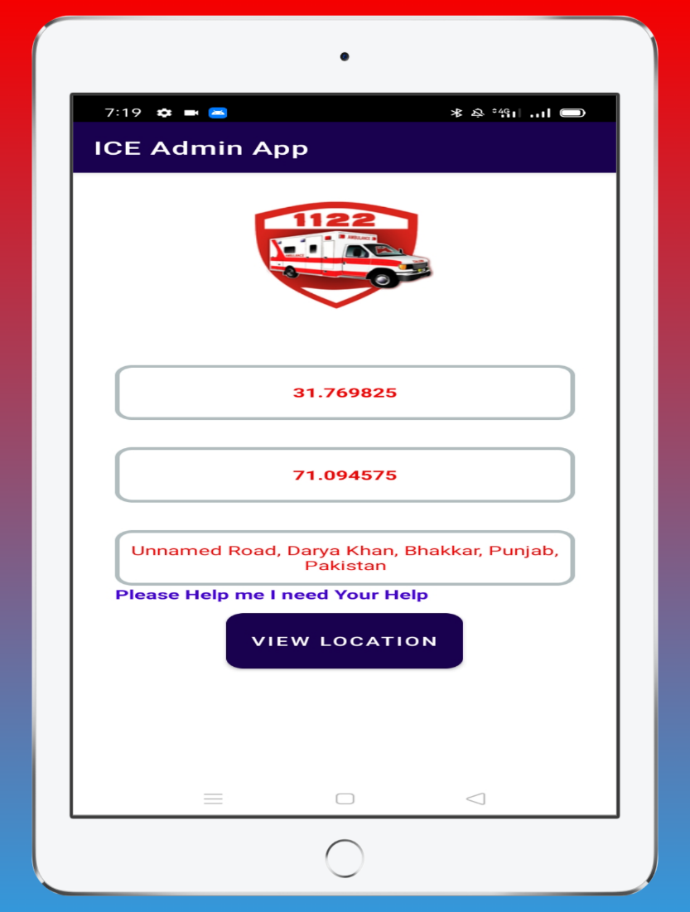
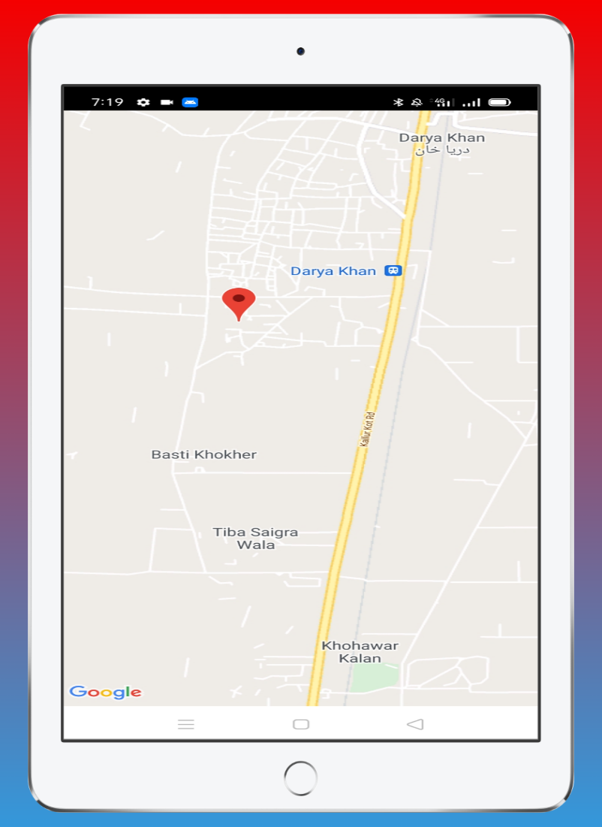
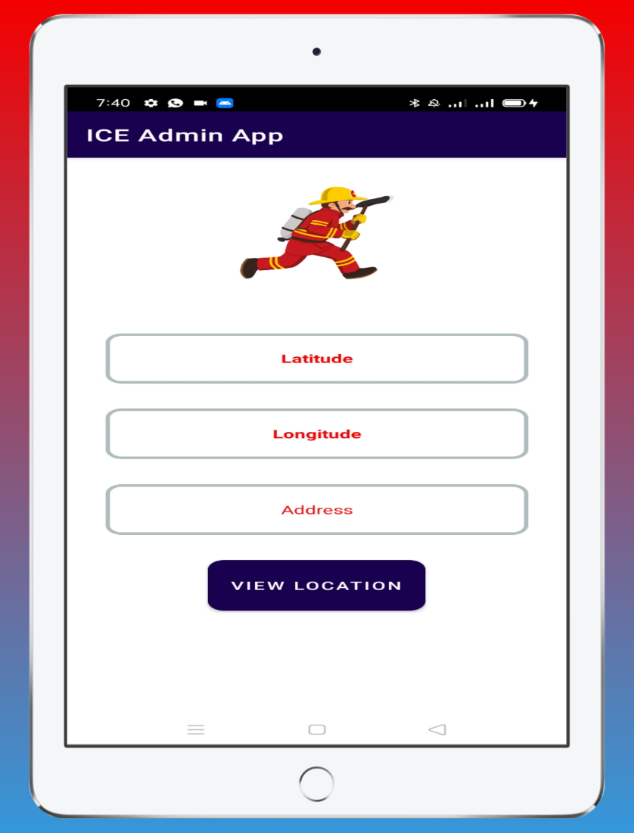
Admin Side Fire Brigade Help View Location On Map Rescue Help

Slide 11

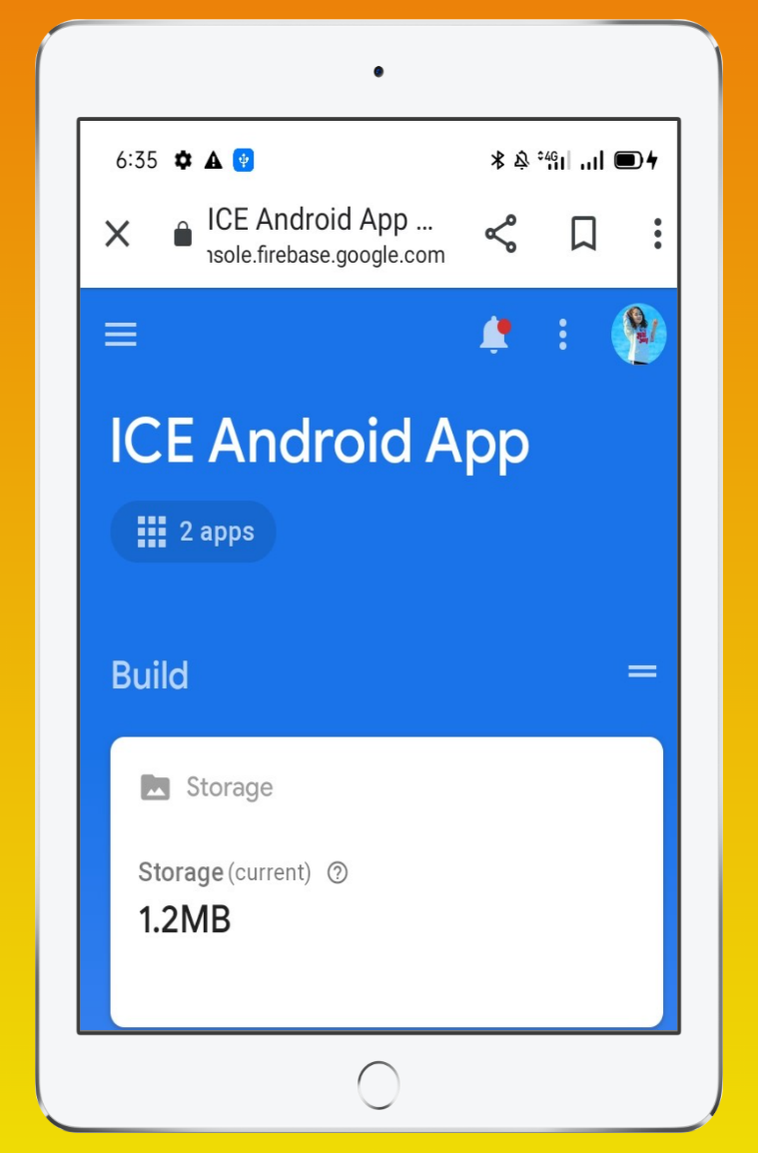
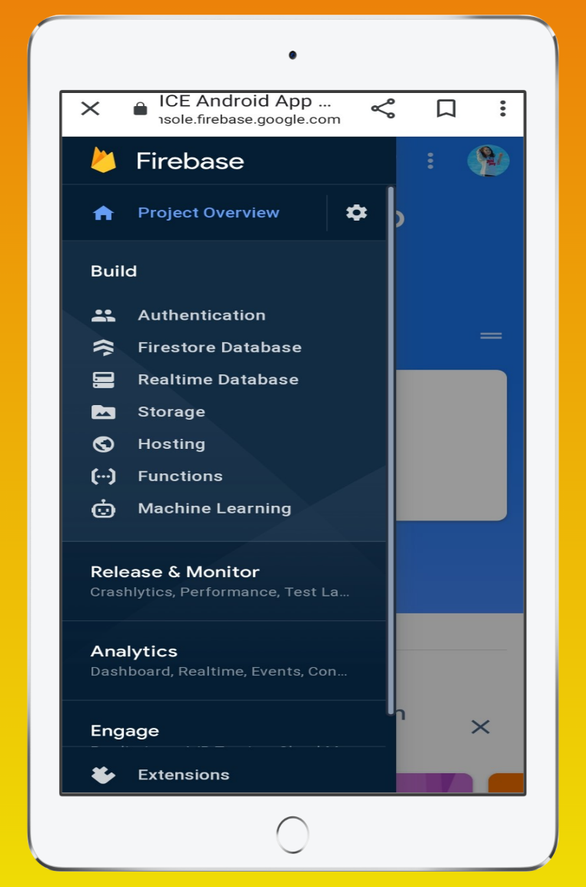
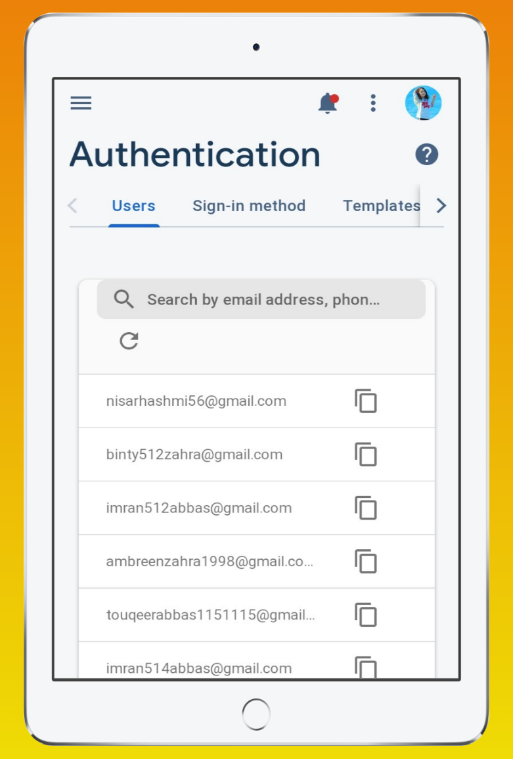
Firebase ICE Android App Authentication

Slide 12
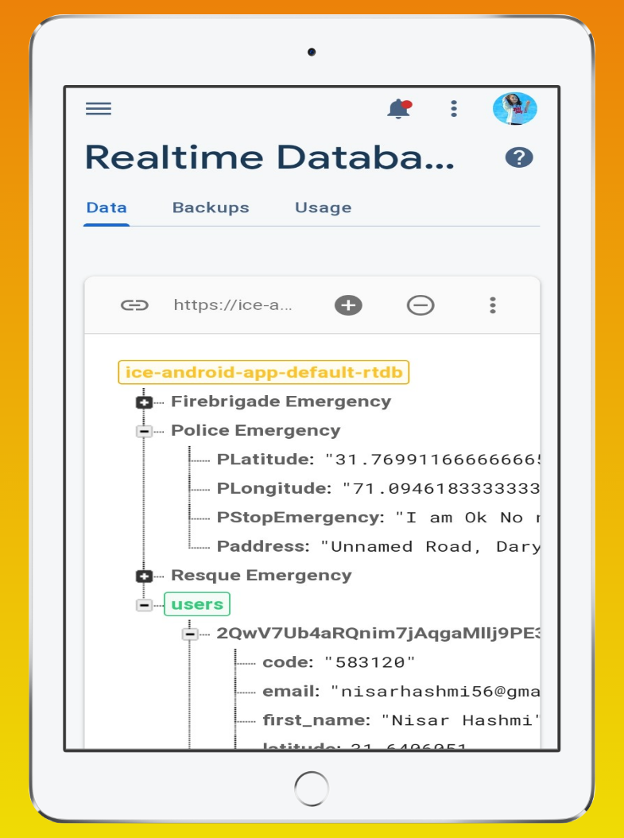
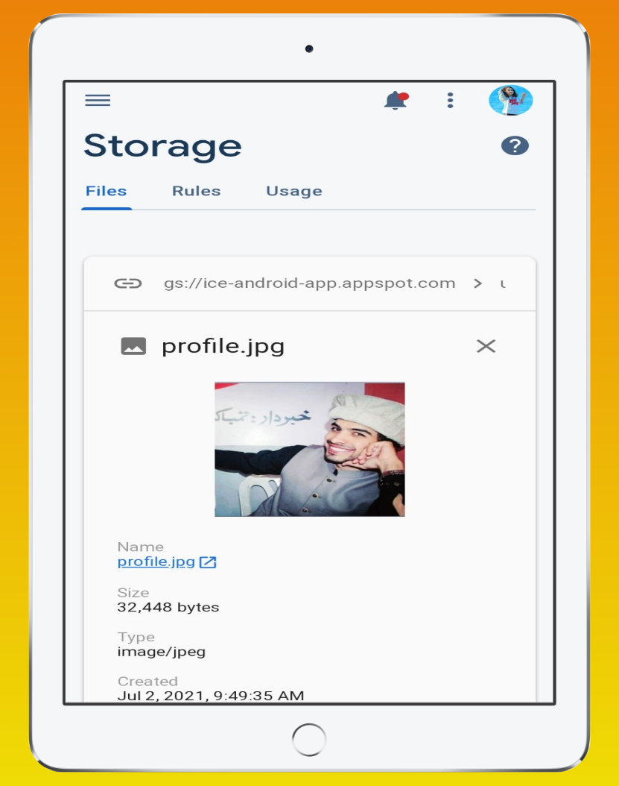
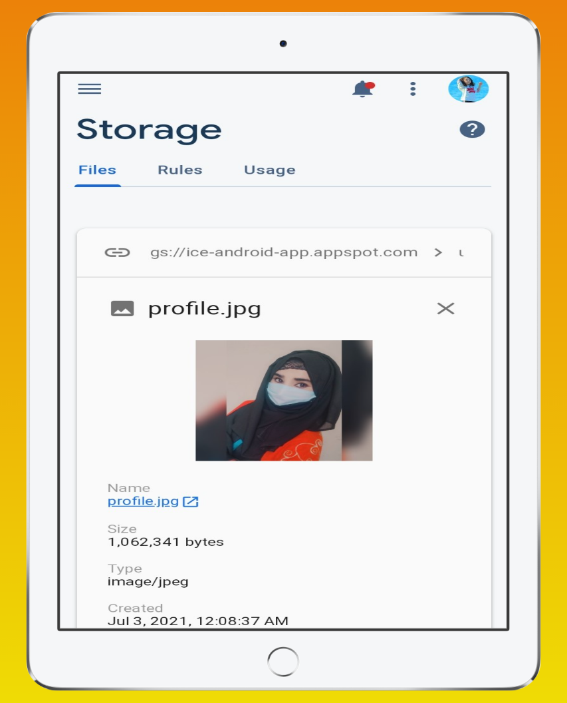
Real Time Database and Storage

